Slide 1

Welcome!
Block 1: Coding Boot Camp
24th – 28th June 2019

Slide 2


Python programming
Why program?

Slide 3
Why program?
Course aims
Learn about -
Algorithms, functions, lists, loops, logic, reading and writing files, finding bugs, displaying results using graphs, etc.
Do -
Undertake a programming project applying skills you have learnt.
Notes:
3

Slide 4
Why program?
The pre-history of programming
Computers are still very new
At the end 19th century machines were developed to automate arithmetic for book keeping and the processing of census data.
By the middle of the 20th century digital computers were solving business problems.
Notes:
4

Slide 5
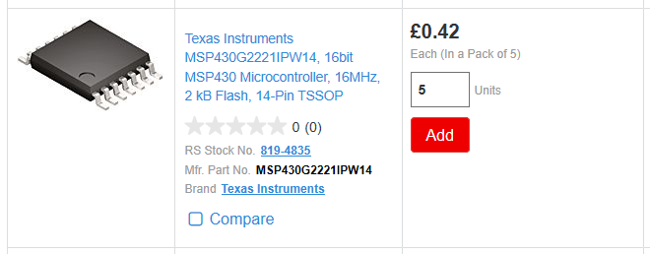
Why program?
Computers everywhere
Towards the end of the 20th century almost everything became digital – TV, music, communication, archiving.
Notes:
Microchips can now be had for pence, they’re just a few mm in size and use hardly any power.
5

Slide 6
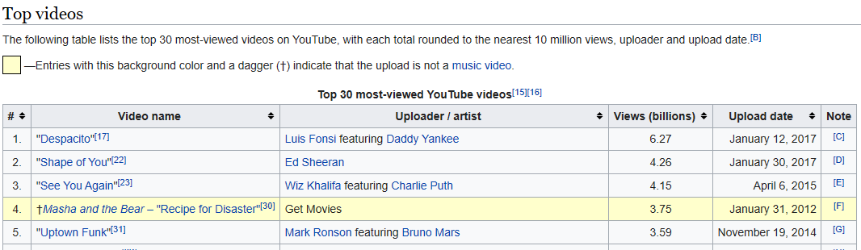
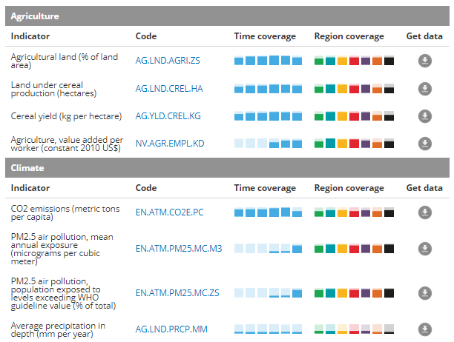
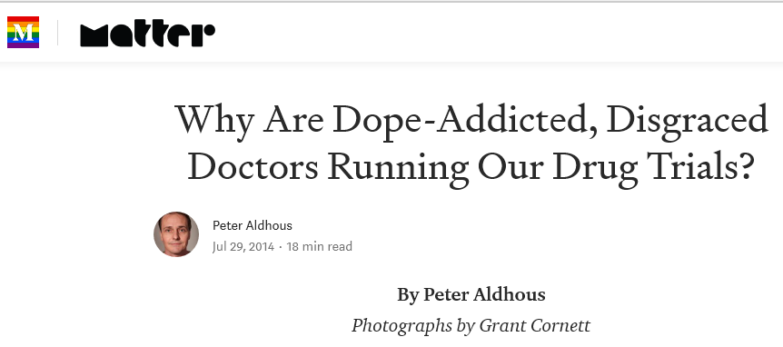
Why program?
Data on everything
Notes:
6

Slide 7
Why program?
Uses for programming
Building software
Solving, or modelling, problems
Manipulating and moving data
Gluing programs together
Adding features to software
Notes:
7

Slide 8
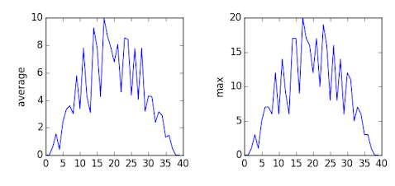
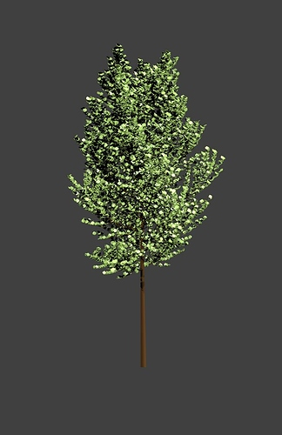
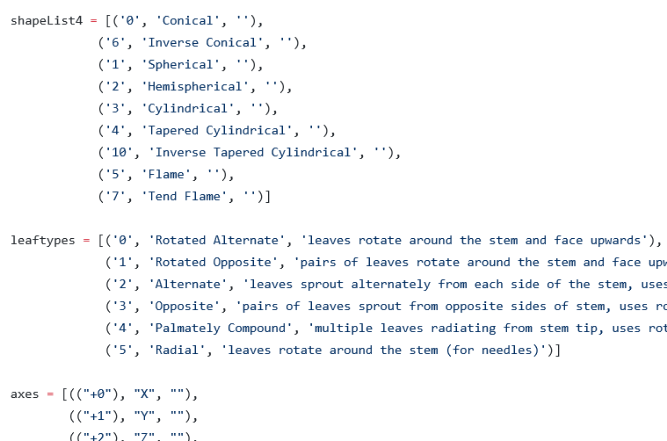
Why program?
Examples
Notes:
Blender, a 3D drawing program can be extended with Python scripts.
8

Slide 9
After this course
Working with research and experiment data
Automating tasks
Learn more Python – Data analysis, ML, Image processing, GIS…
Learn other programming languages
Teach it forward – help a friend learn Python
Notes:
9

